Slide 1
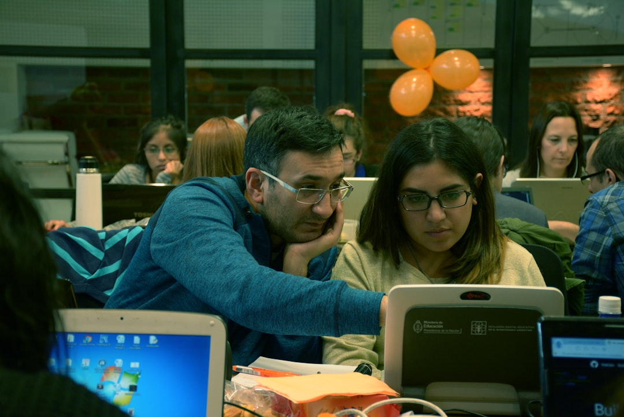
Humans Think Computers Obey!
Let's Explore Flowcharts and Algorithms!

Slide 2

LEARNING OBJECTIVES
1. Students will be able to predict outcomes of flowcharts.
2. Students will know a sub-routine can be used multiple times.
3. Students will identify sub-routines in algorithms.

Slide 3
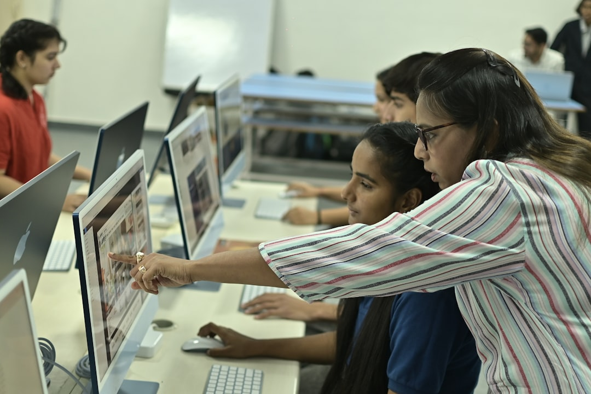
Do Computers Think?
Can computers think like humans?
They follow instructions given by us.
Discuss how flowcharts help visualize instructions.
Example Think of following a recipe to bake cookies.
Notes:
Engage students with the question about computers. Encourage them to share their thoughts and ideas. Explain that computers do not think for themselves; they follow the instructions we give them.

Slide 4
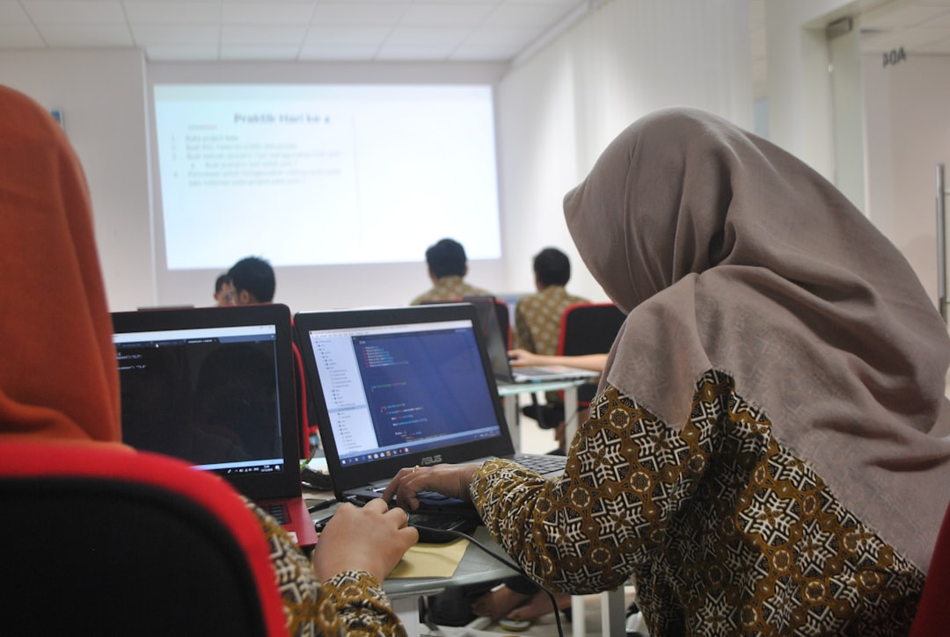
Introduction to Flowcharts
Flowchart — A visual representation of a process with steps and decisions.
Example Drawing a flowchart to show how to make cereal.
Notes:
Introduce flowcharts as a way to visualize steps in a process. Explain each shape's meaning (e.g., ovals for start/end, rectangles for steps, diamonds for decisions). Use a simple example like making cereal to illustrate.

Slide 5
WORKED EXAMPLE
Creating a Flowchart
Create a flowchart for a sandwich-making process
1
Start with 'Start' in an oval.
2
Add rectangles for each step: 'Take bread', 'Add peanut butter'.
3
Incorporate a diamond for decision: 'Add jelly?'.
Notes:
Guide students as they create their flowcharts. Provide a template if necessary. Monitor their progress and encourage creativity in their decision points.

Slide 6

What is a Sub-Routine?
Sub-routine — A part of an algorithm that can be used multiple times.
Example Tying your shoes is a sub-routine.
Notes:
Explain sub-routines using relatable examples such as daily activities. Discuss how breaking tasks into smaller parts (sub-routines) makes complex algorithms simpler and reusable.

Slide 7
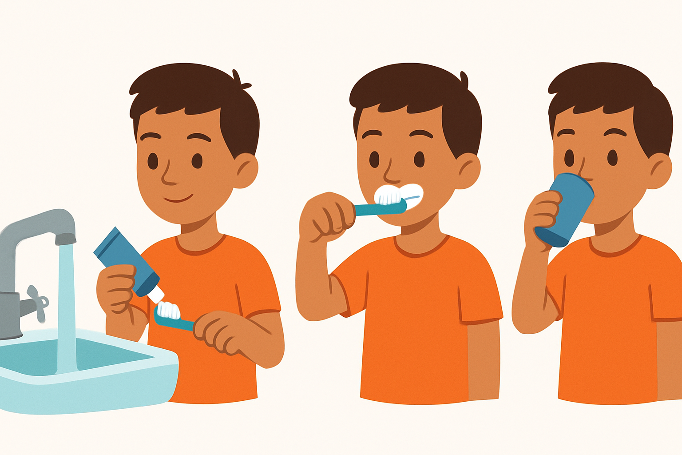
Finding Sub-Routines in Daily Life
Think of your daily routines.
Identify any repeated tasks.
Share examples with classmates.
Example Brushing teeth often follows the same steps every time.
Notes:
Encourage students to brainstorm daily routines with repeated tasks that could represent sub-routines. Ask individuals to share their examples with the class.

Slide 8
WORKED EXAMPLE
Create an Algorithm Game
Create a game algorithm
1
Choose a familiar game.
2
Outline the main instructions.
3
Identify any repeated actions as sub-routines.
Notes:
Explain the activity meaningfully, telling students to decide on a game they all know, then draw an algorithm including at least one sub-routine. Aid groups as they create.

Slide 9
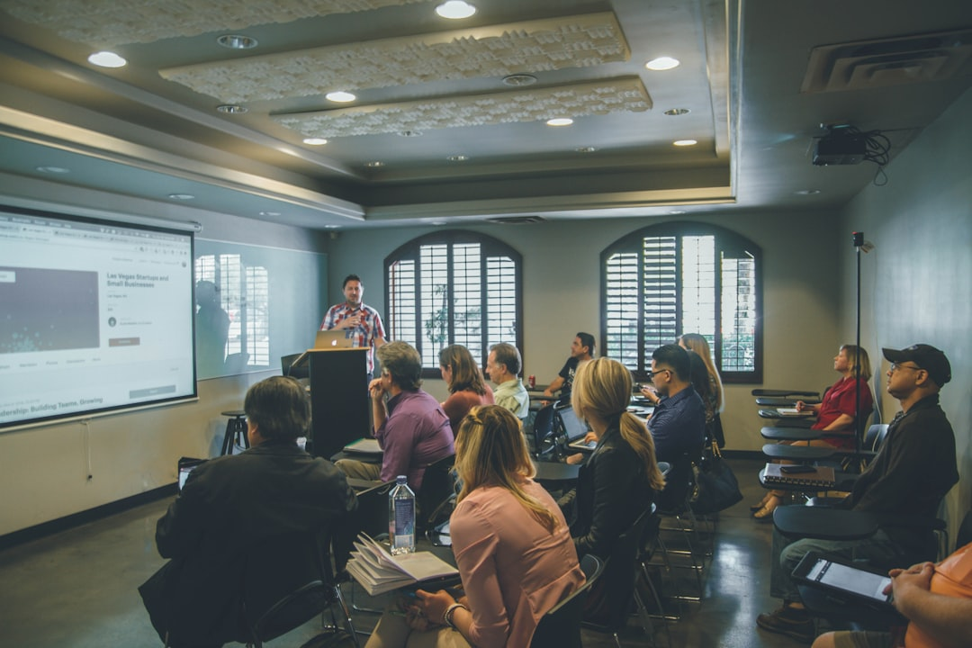
Presenting Our Algorithms
Share with the class your algorithm.
Explain why you chose your sub-routines.
Discuss the flow of your steps.
Example Explain your algorithm for your favorite game.
Notes:
As groups present, encourage interaction and questions from classmates. Emphasize the importance of flowcharts and algorithms in computer instructions.

Slide 10
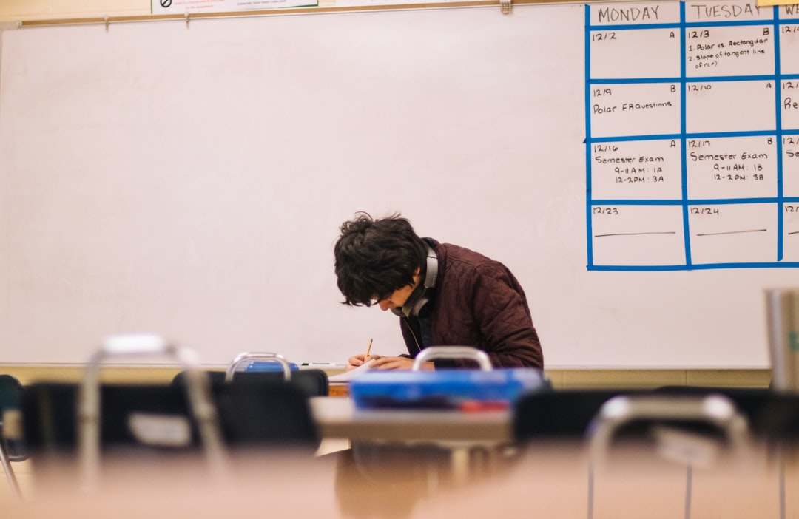
Recap & Reflection
What is a flowchart?
How do sub-routines work?
Why are algorithms important?
Example Reflect on your learning process today.
Notes:
Summarize the learning points from the lesson. Engage students in expressing their thoughts through reflections and discussions.

Slide 11
Check for Understanding!
What do flowcharts help us do?
Why are sub-routines used?
Explain in your own words.
Example Use a flowchart to show a process at home.
Notes:
Ask students to think and respond to the question about flowcharts and sub-routines. Review the responses to confirm understanding.

Slide 12
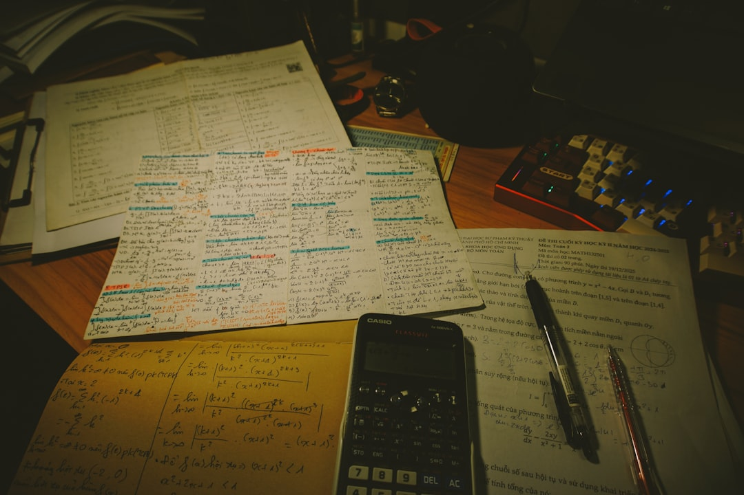
Your Turn! Homework
Create a flowchart of a task at home.
Write about how flowcharts help.
Prepare to share next class.
Example Show how you brush your teeth with a flowchart.
Notes:
For homework, explain that students are to create a flowchart for a simple task and write one sentence about the benefits of flowcharts. Prepare to share in class.

Slide 13

QUICK CHECK
What is a flowchart used for?
It visually represents a process.
It helps us understand instructions better, showing steps clearly.

Slide 14
YOUR TURN
Flowchart Creation Challenge
Goal: Create a flowchart illustrating a simple process.
You'll need: Paper, Markers, Examples of flowcharts
Choose a process you know well (like a morning routine).
Sketch it out as a flowchart on paper.
Use shapes like ovals for start/end and rectangles for steps.
Notes:
Goal: Create a flowchart illustrating a simple process.
Materials: Paper, Markers, Examples of flowcharts
Guide students to pick simple processes they understand. Encourage creativity by asking them to add colors and designs while emphasizing clarity.
Support (students who find it hard): Pair students who need help with those confident in flowchart creation.
Challenge (fast finishers): Challenge fast finishers to add more complex sub-routines to their algorithms.

Slide 15
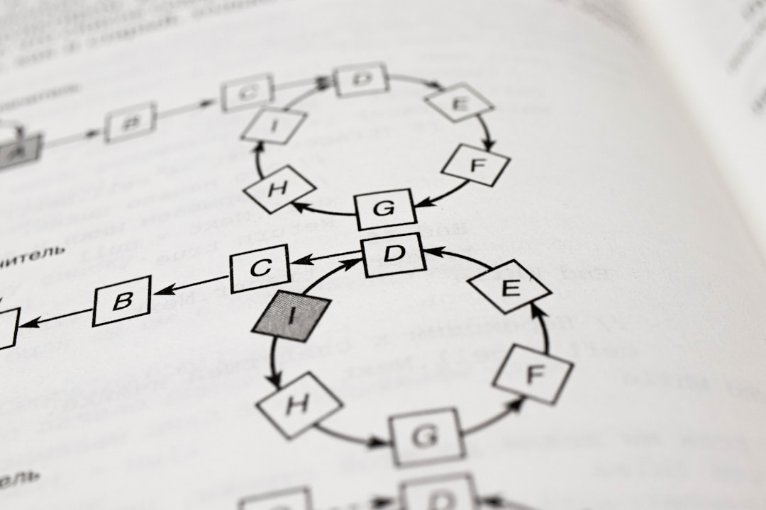
Recap
Flowcharts help us visualize processes.
Sub-routines are reusable parts of algorithms.
Algorithms are crucial for computer instructions.

